Slide 1
English Lexical Semantic Evolution across Time
Sangpil Youm, He Zhou

Slide 2
Introduction
Human language is undergoing a constant evolution driven by the ongoing change in the real world: new concept, language contact, etc.
Language change: phonetic&phonological, morphological, syntactic, semantic
Lexical semantic change: diachronic evolution of lexicon usage, which is easier to change compared with other components of language.
“Every word has its own history.”
Theoretically, lexical semantic change mainly includes 3 ways:
1. Broadening 2. Narrowing 3. Shift
Notes:
Lexical change including the appearance of new words and lexical semantic change is accelerated after Internet or social media being widely accessible, i.e., more new concepts show up, more communications between people.

Slide 3
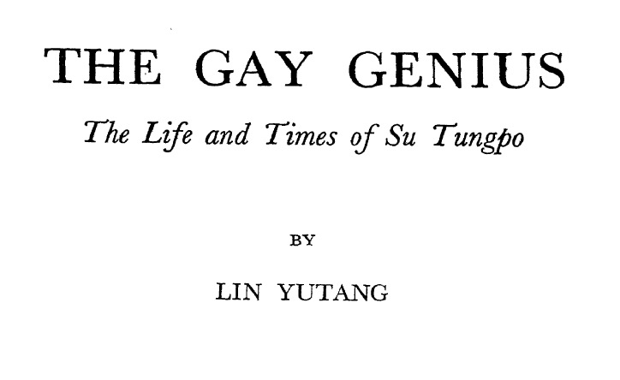
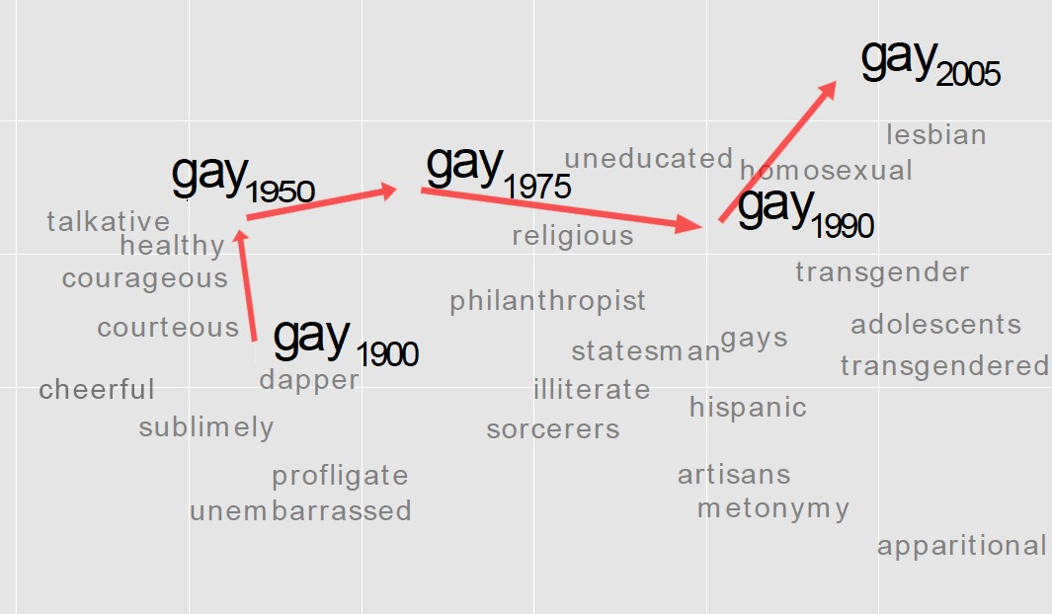
Questions:
Can we figure out what words have changed in meaning through time?
If a word has changed its meaning, when and how?
Can we analyze the diachronic change from network science perspectives?
Notes:
Theoretical linguists and historical linguists observed language data through time by referring to classics in different time periods.

Slide 4
Related Work
Adam Jatwot et al. 2014.
A Framework for Analyzing Semantic Change of Words across Time
A visual analytics framework for discovering and visualizing lexical change at 3 different levels -- individual words, word pairs, sentiment orientation
Data: Google Book 5-gram, COHA
Word Representations:
Normal Word Representation
Positional Word Representation
Latent Semantic Analysis based Representation

Slide 5
Vivek Kulkarni et al, 2015
Statistically Significant Detection of Linguistic Change
Word Evolution Modeling: frequency, syntactic, distributional
Statistical Soundness: use change point detection in time series to assign significance of change scores to each word
Cross-Domain Analysis: books, tweets and online reviews
Data: Google Book N-gram, Tweets, Amazon reviews

Slide 6
William Hamilton et al. 2016
Diachronic Word Embeddings Reveal Statistical Law of Semantic Change
Developed a robust methodology for quantifying semantic change by evaluating word embeddings (PPMI, SVD, word2vec) against known historical changes.
Data: 6 historical corpora spanning 4 languages and 2 centuries.
Two quantitative laws of semantic change:
1) the law of conformity- frequent words change more slowly
2) the law of innovation - polysemous words change more quickly
Notes:
Previous view: semantic change leads to polysemy. This research tends to say that polysemy may actually lead to semantic change.

Slide 7
Data
English Literature from Gutenberg Project
17th Century 200 books (5,741,155)
19th Century 200 books (141,422,786)
20th Century 200 books (till around 1970s) (86,618,416)
21st: Google News Embeddings
Preprocessing:
Convert all capital letters to lower-case
Remove all punctuations
Remove stopwords with NLTK
Notes:
Number of set of words => 17c : 190,013, 19c : 234,951, 20c : 168572

Slide 8
Method
Word-embeddings (word2vec) for words in each time period
Default setting, bigram detection
Analogy test
ex) “King - Man + Woman = Queen”
Measure distance between words with cosine similarity
Find out similar meaning words
Figure out semantic change among different time periods
Notes:
Sangpil

Slide 9
Method
Build a word list in which all words show up in both periods
17th vs 20th, 19th vs 20th
Make vocab containing words appeared in both time perionds
Randomly sample 1,000 words from the word list

Slide 10
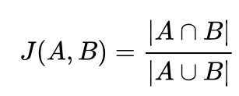
Method
Network Analysis
Generate graph with selected words and similar words based on cosine similarity
Calculate Jaccard Coefficient for each word in different time periods
17th vs 20th, 19th vs 20th
Plot the correlation between Jaccard coefficient and frequency

Slide 11
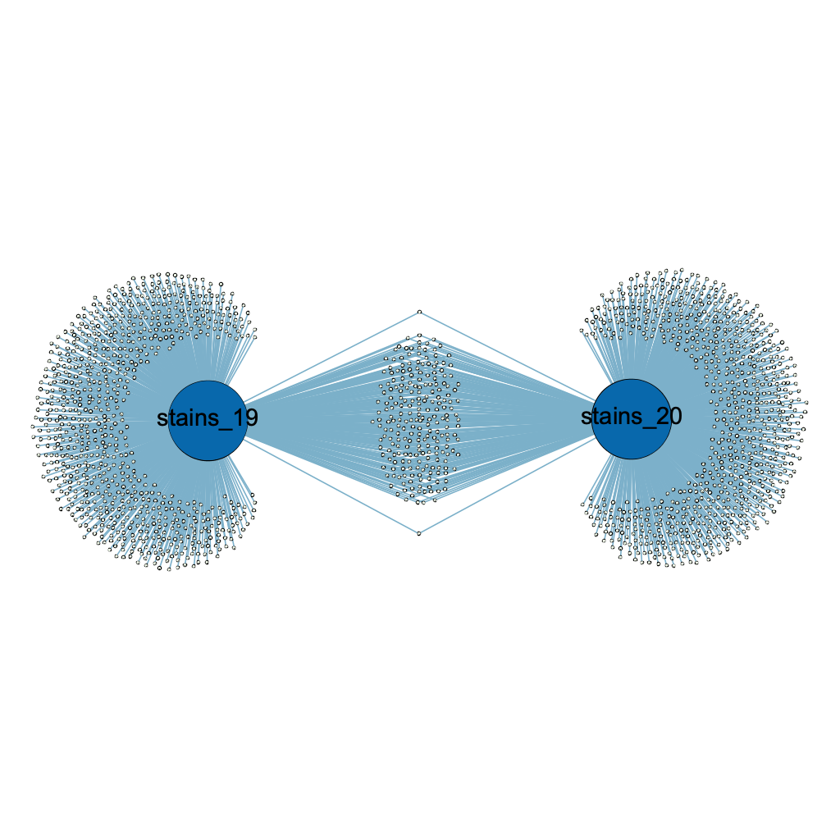
Method
Network Analysis
Cosine similarity threshold 0.8

Slide 12
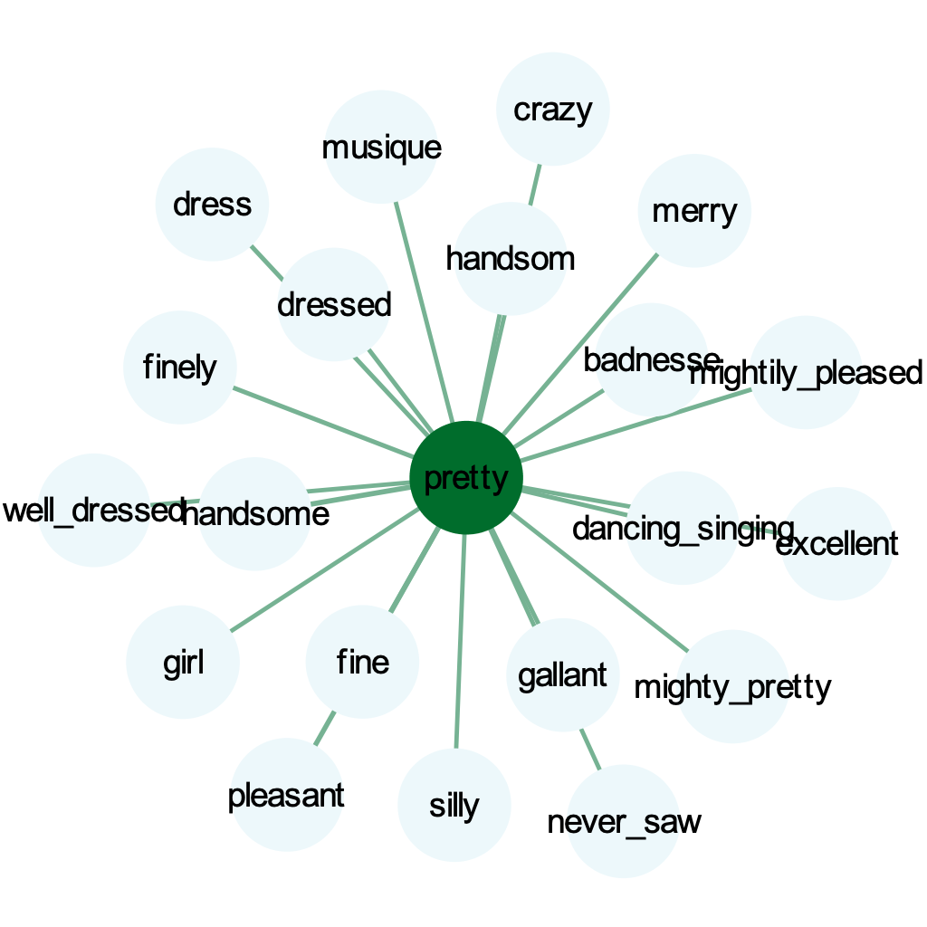
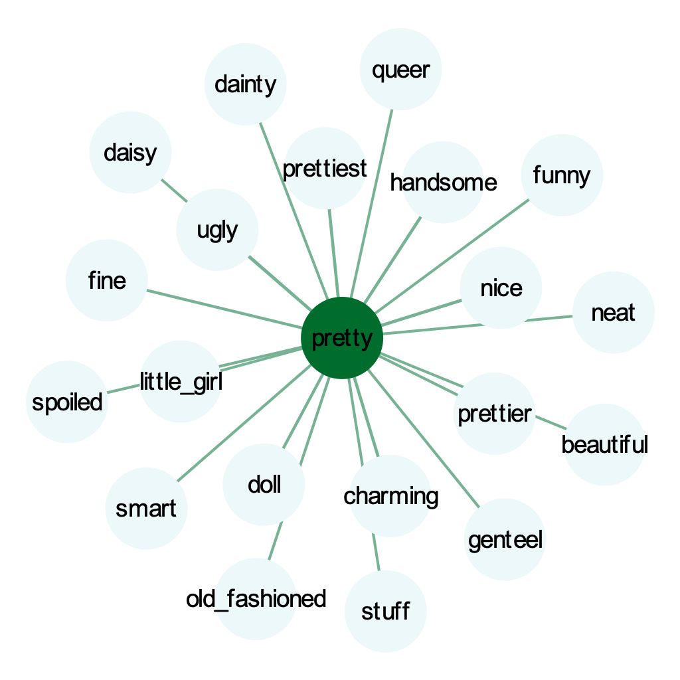
Result pretty (ADJ → ADV)
‘pretty’ - 17th century
‘pretty’ - 19th century
Notes:
He

Slide 13
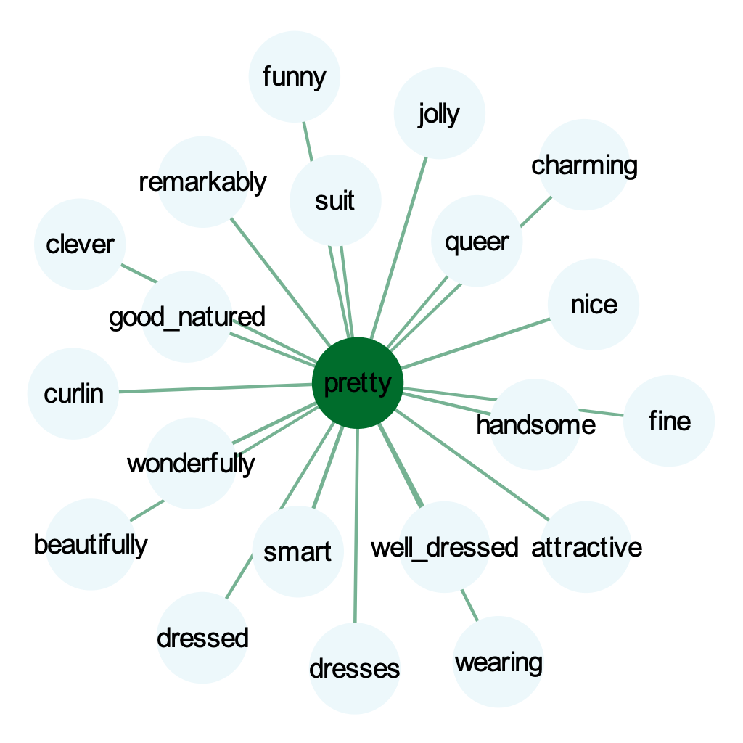
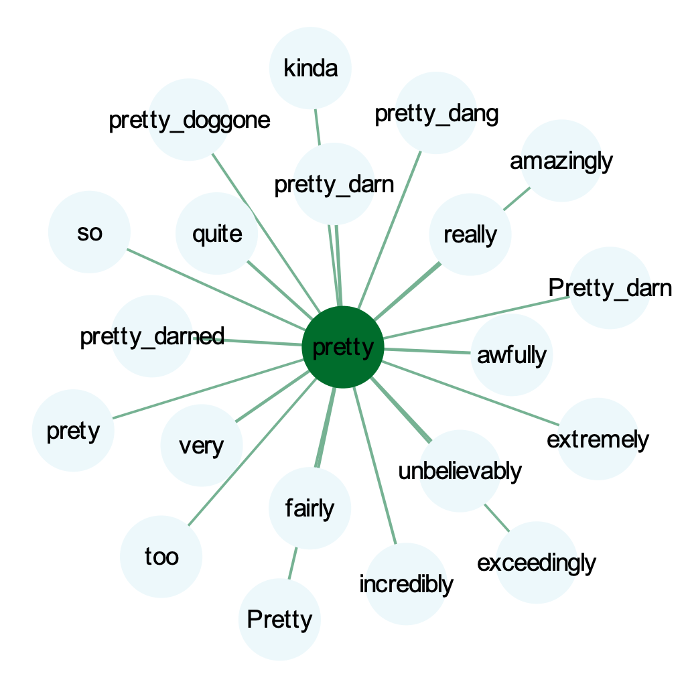
‘pretty’ - 20th century
‘pretty’ - 21st century

Slide 14
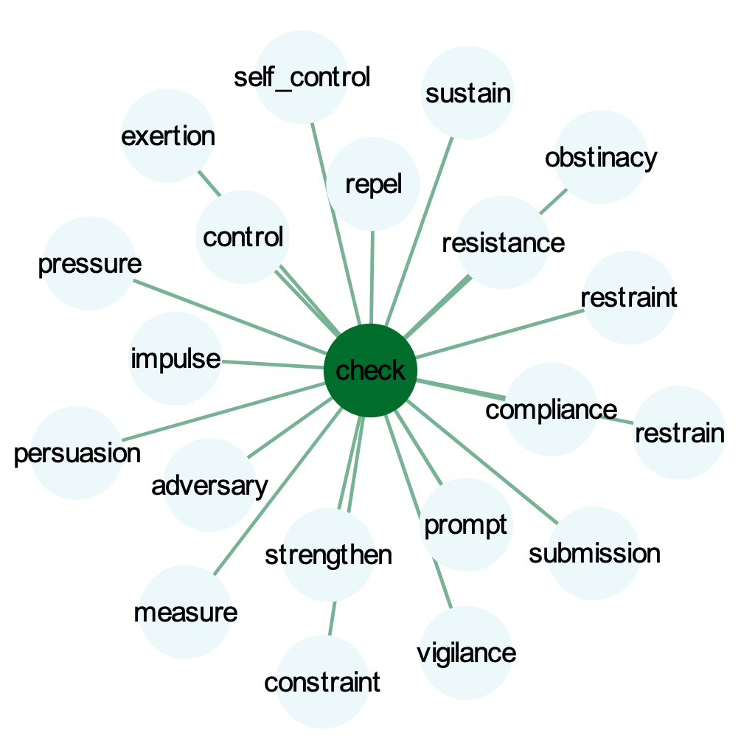
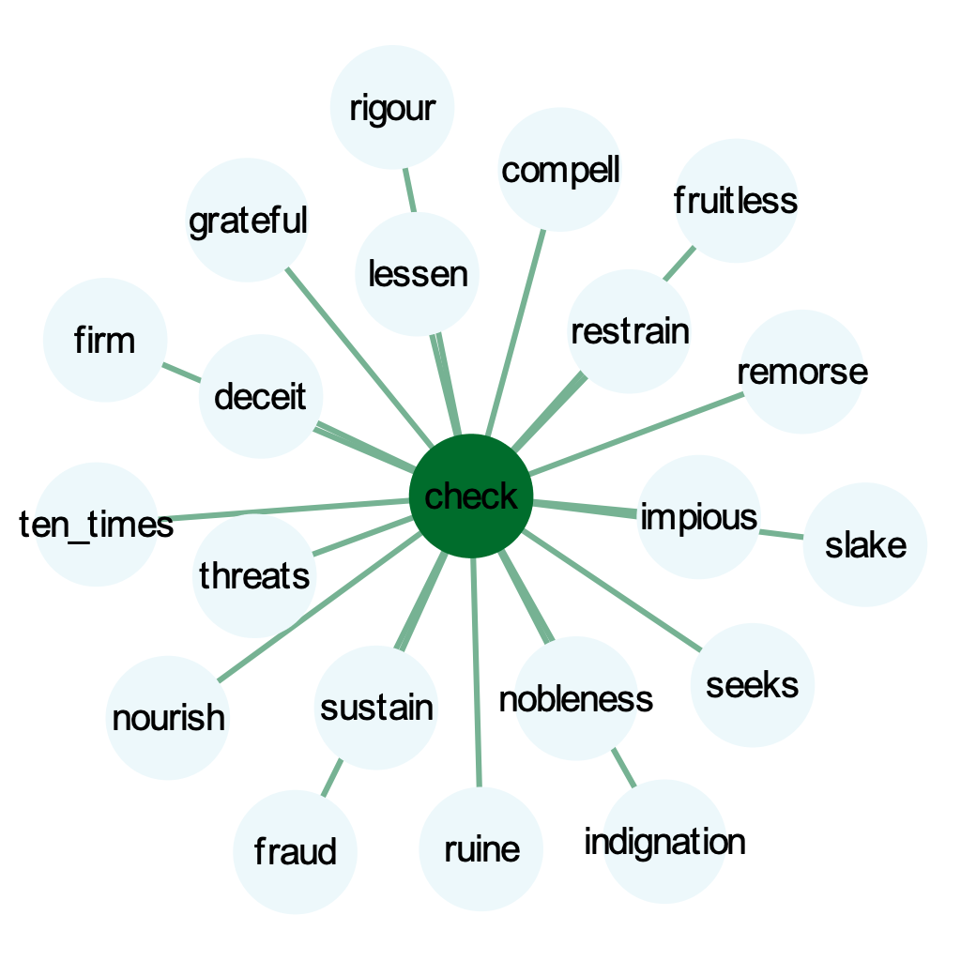
check (VERB → NOUN)
‘check’ - 17th century
‘check’ - 19th century

Slide 15
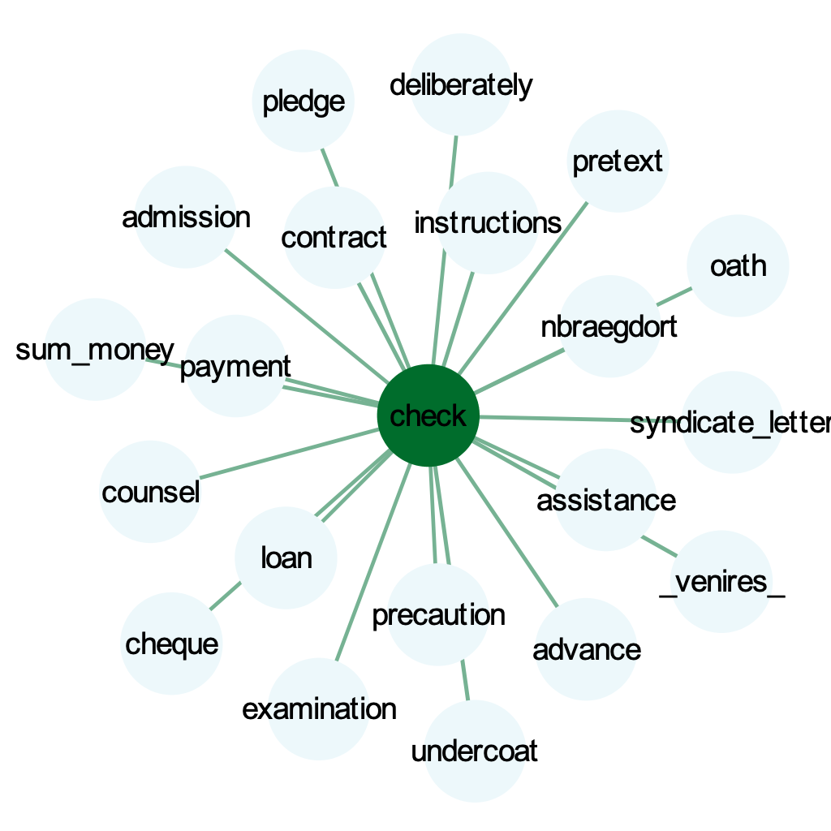
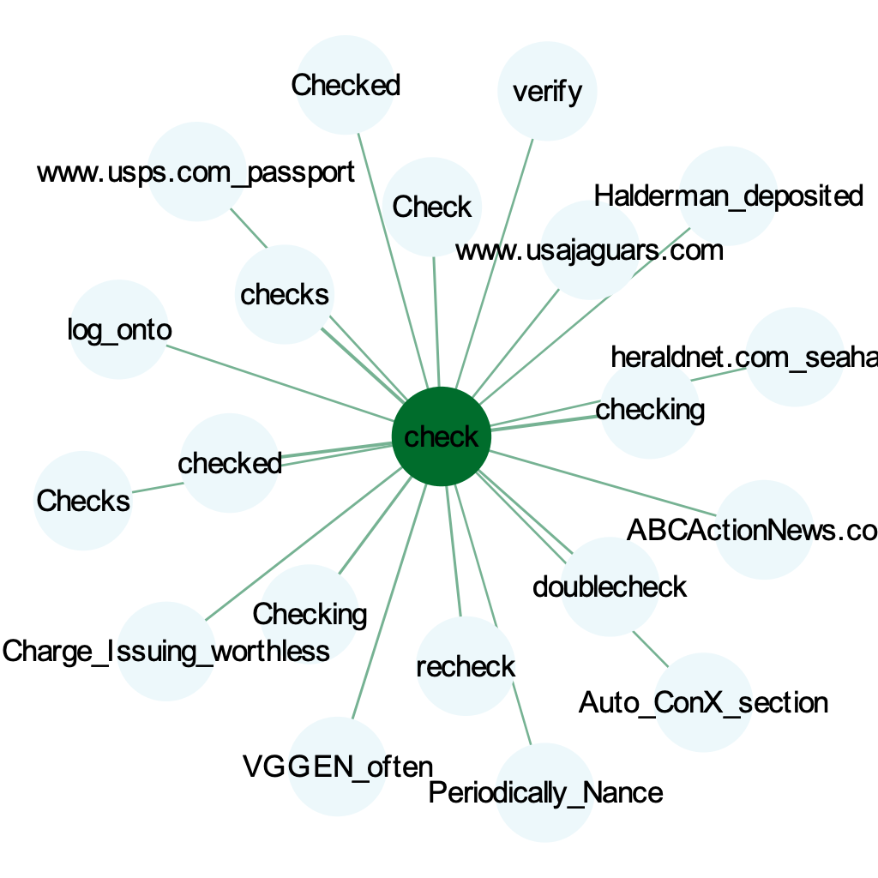
‘check’ - 20th century
‘check’ - 21st century

Slide 16
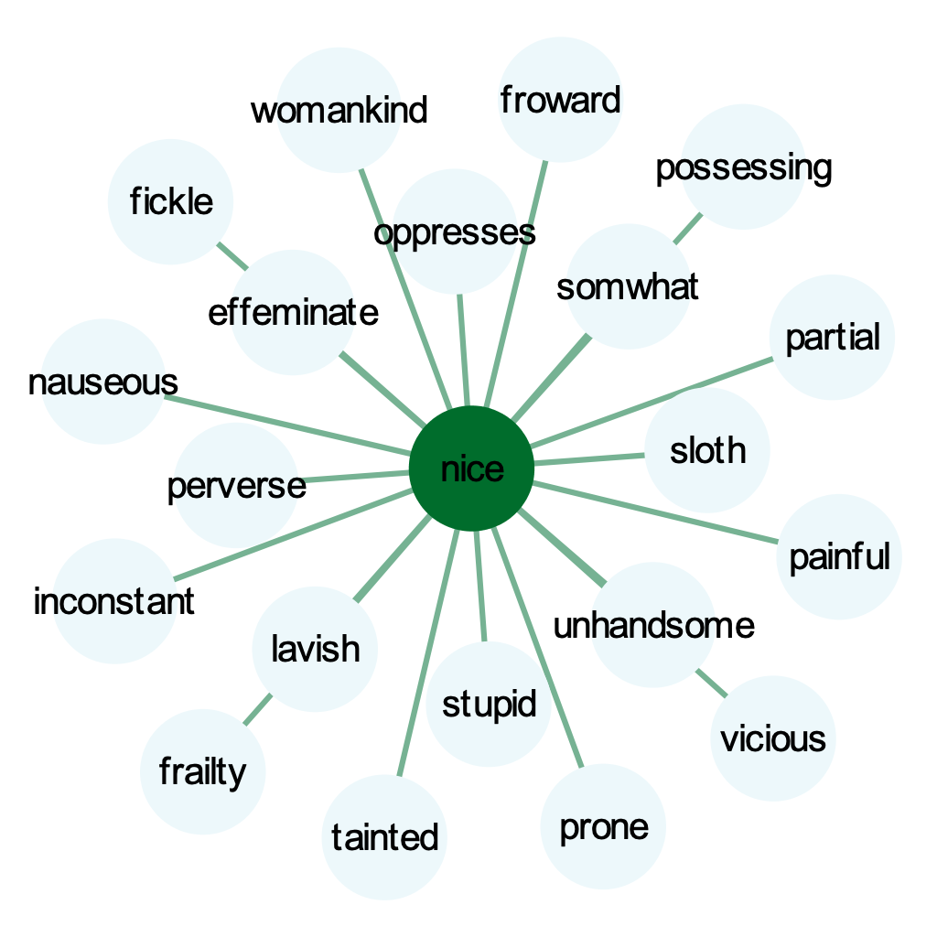
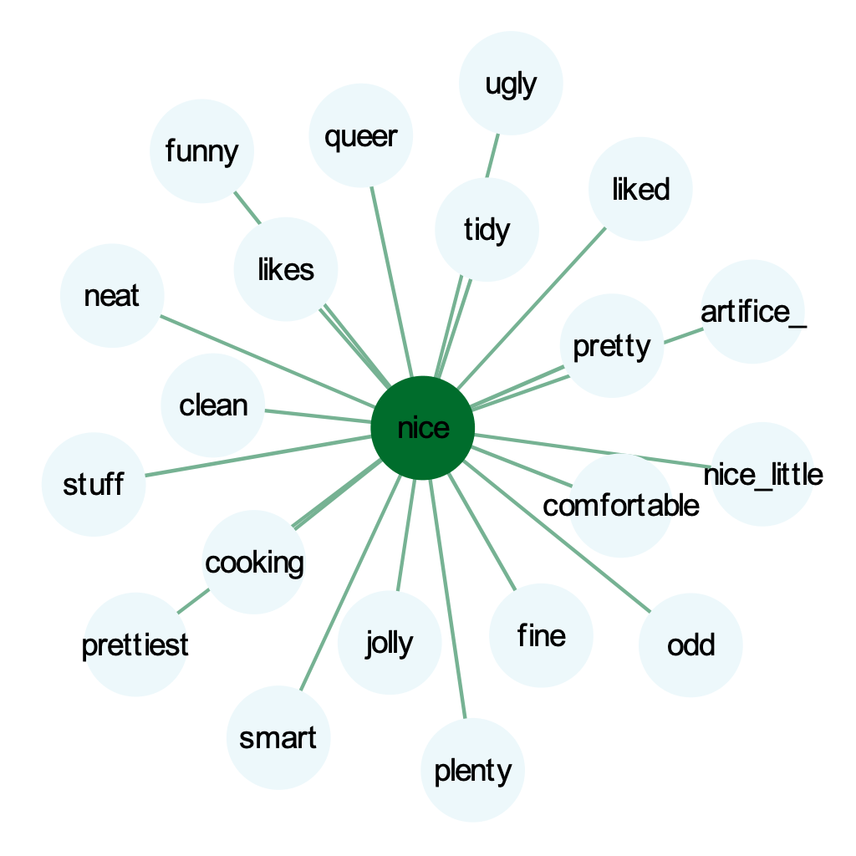
nice (negative → positive)
‘nice’ - 17th century
‘nice’ - 19th century

Slide 17
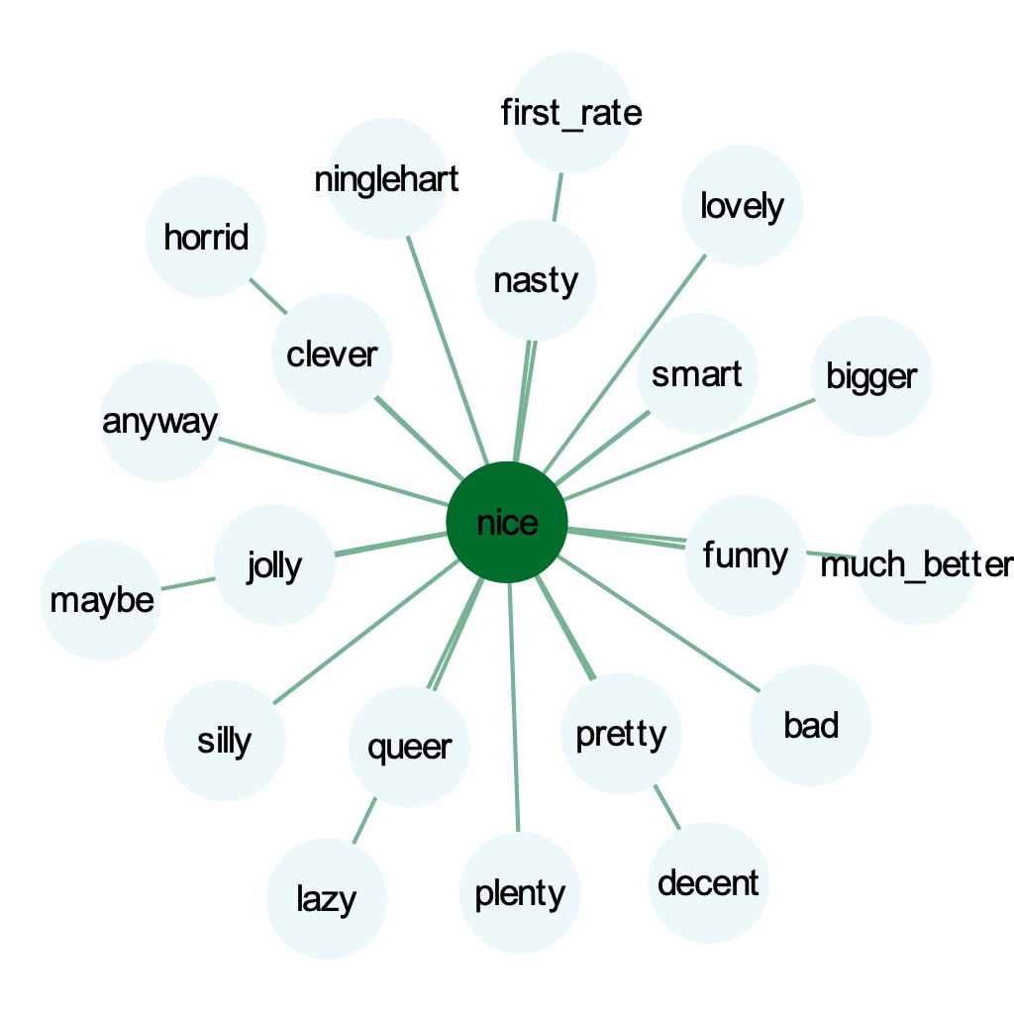
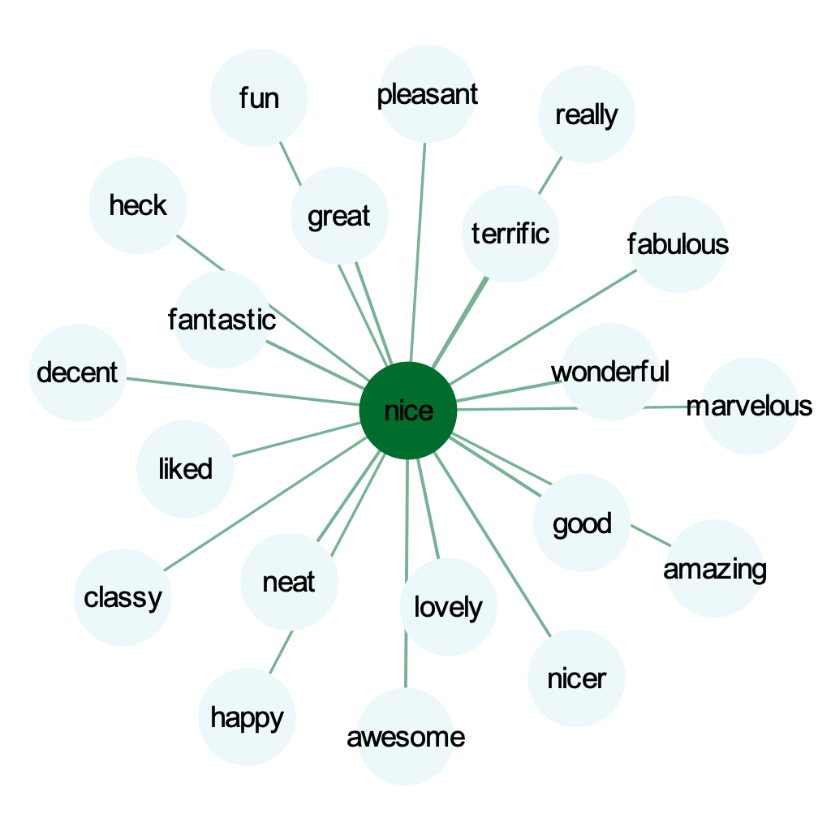
‘nice’ - 20th century
‘nice’ - 21st century

Slide 18
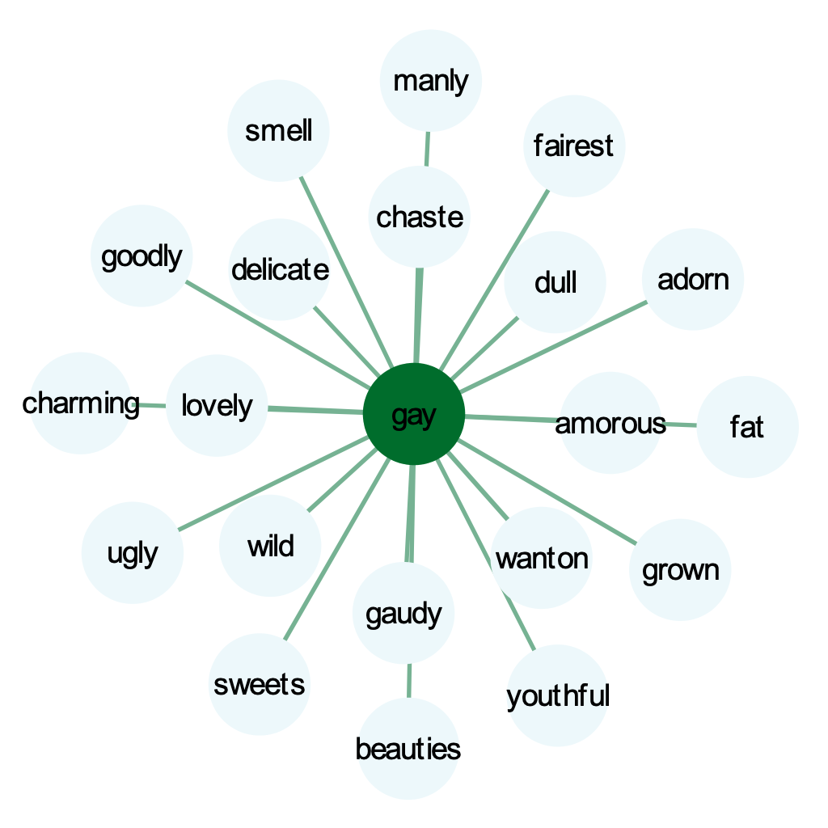
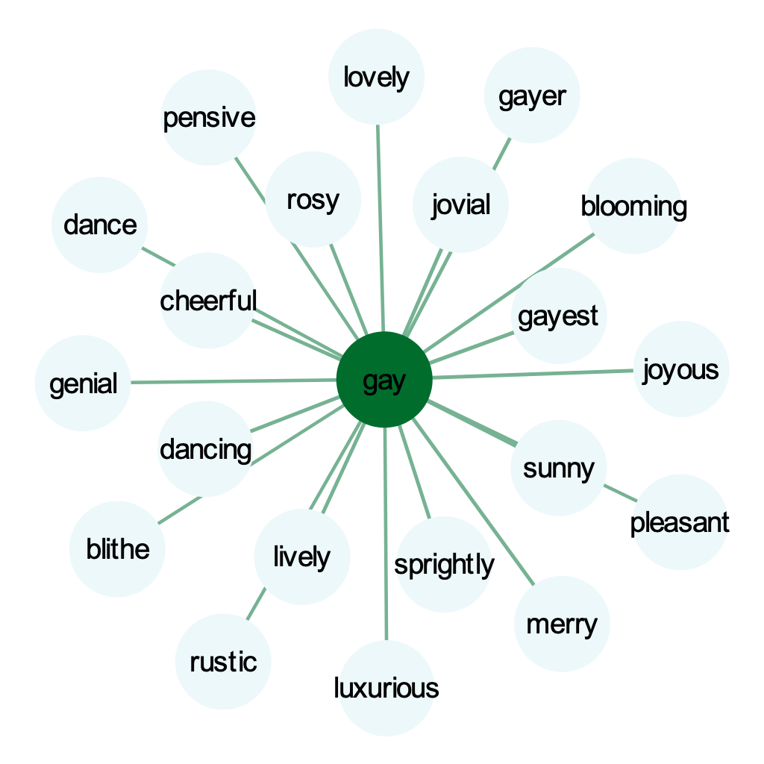
gay
‘gay’ - 17th century
‘gay’ - 19th century

Slide 19
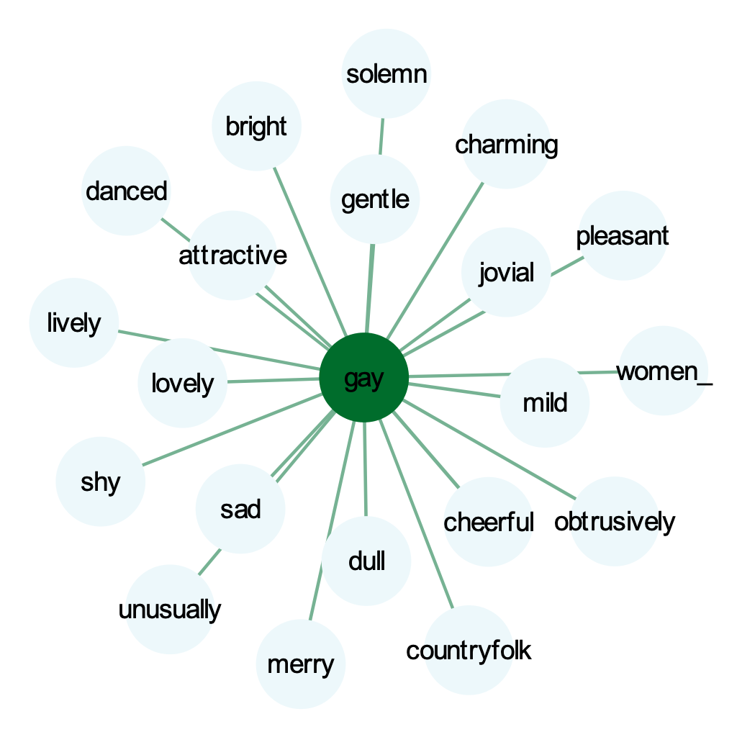
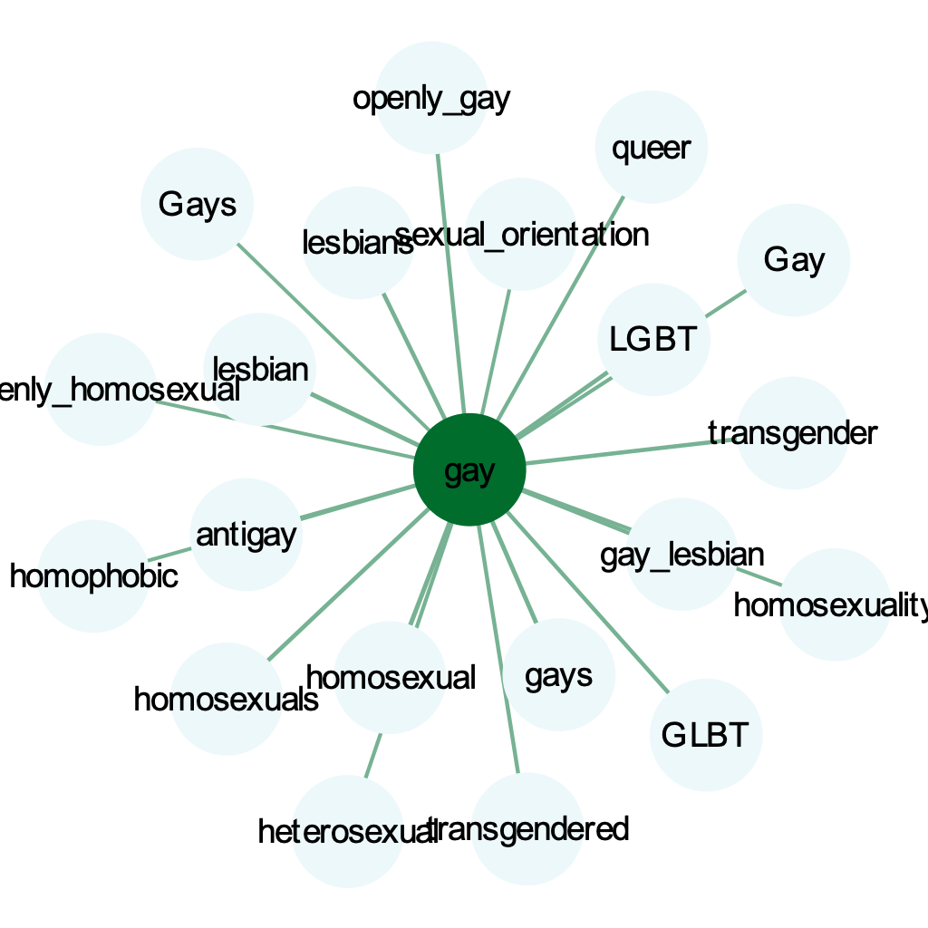
‘gay’ - 20th century
‘gay’ - 21st century

Slide 20
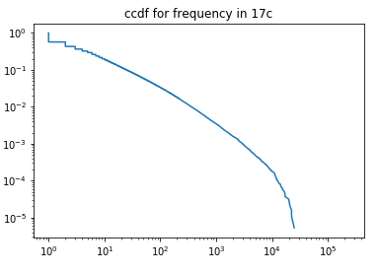
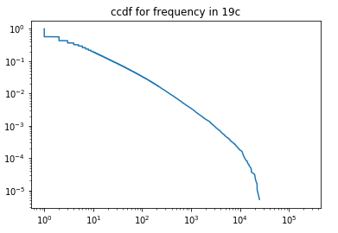

Frequency
Notes:
Sangpil

Slide 21
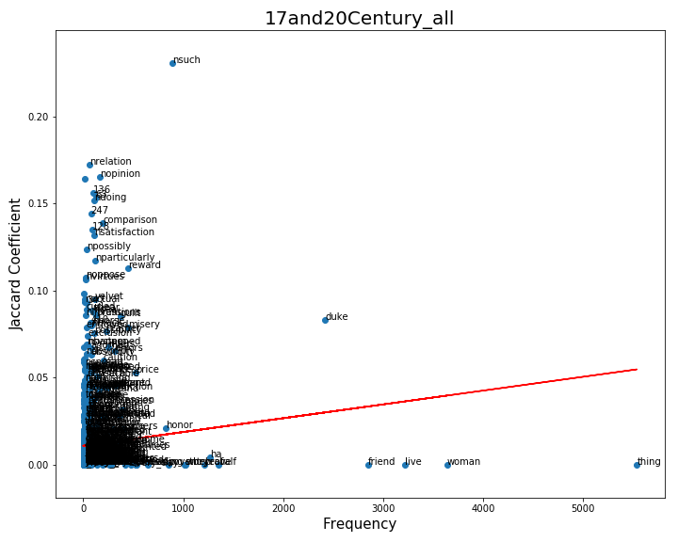
Notes:
Sangpil

Slide 22
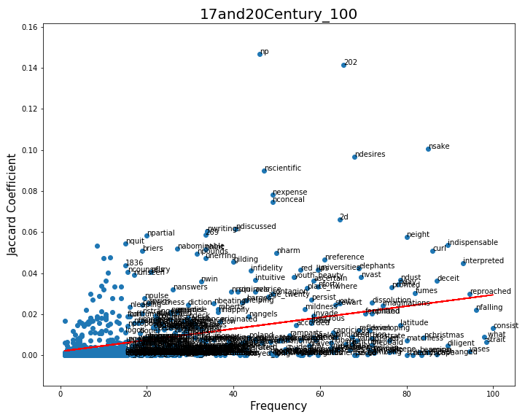

Slide 23
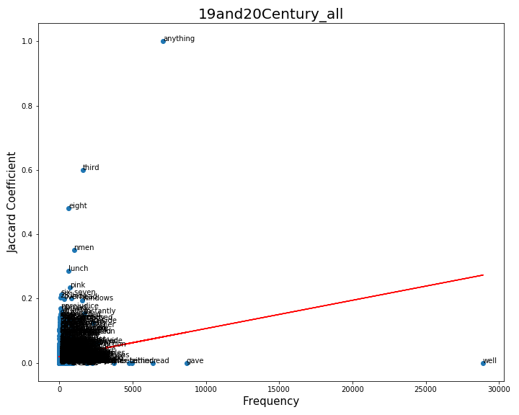

Slide 24
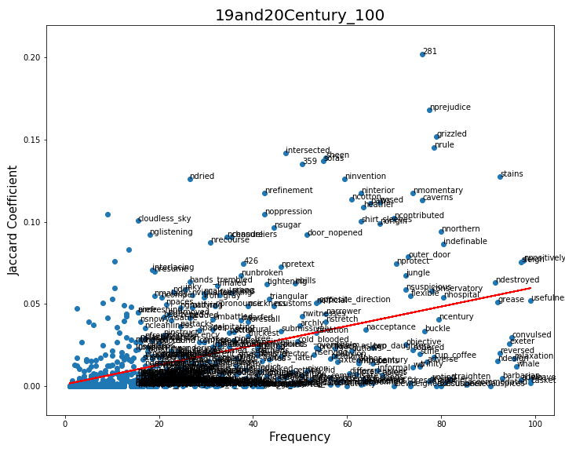

Slide 25
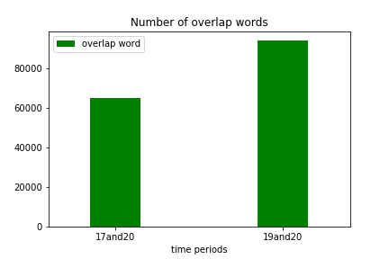
Number of overlap words

Slide 26
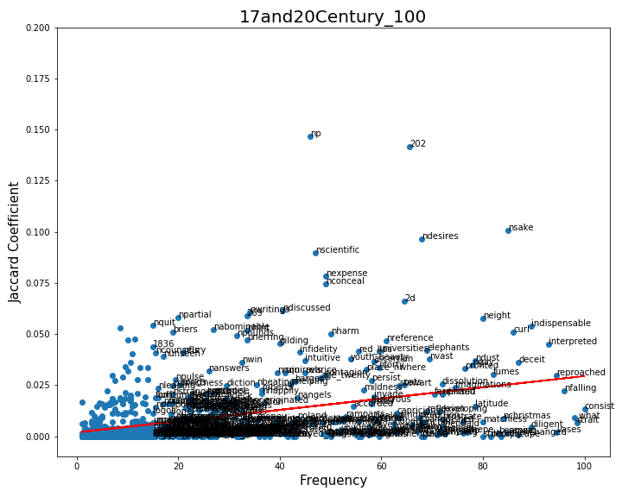
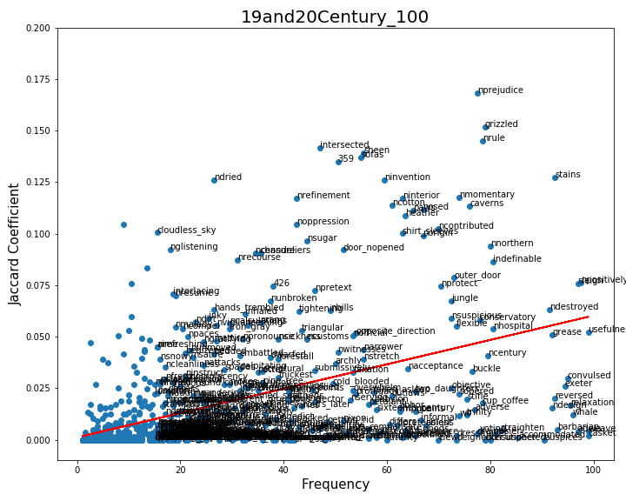
Words have changed overtime
863 words
868 words
Notes:
863 868

Slide 27
Conclusion & Future Work
Conclusion:
1. Semantic change can be detected within the limited amount of data.
Semantic change over time
2. Relation between semantic change and frequency can be shown with network analysis.
Higher frequency words have less semantic change
Words have been changed over time

Slide 28
Conclusion & Future Work
Future Work:
1. Data is never enough
2. Better way to represent word meaning, e.g.: transfer learning on Google Book N-gram
3. More measures

Slide 29
Thank you
&
Any feedback is welcomed!

